Slide 1
Design Pattern
Nick
2015.07

Slide 2
Factory Pattern
Singleton Pattern
Template Pattern
Command Pattern
Decorator Pattern
Observer Pattern
Strategy Pattern
Façade Pattern
Proxy Pattern
Null Object Pattern
Composite Pattern
Visitor Pattern
Adapter Pattern
Builder Pattern
State Pattern
Bridge Pattern
Iterator Pattern

Slide 3
OO Basics
Abstraction
Encapsulation
Polymorphism
Inheritance

Slide 4
OO Principles
Encapsulate what varies
Favor composition over inheritance
Program to interfaces, not implementations
Strive for loosely coupled designs between objects that interact
Classes should be open for extension but closed for modification
Depend on abstractions. Do not depend on concrete classes
Don’t call me, we will call you
A class should have only one reason to change
…

Slide 5
Factory Pattern
Factory Pattern
Abstract Factory Pattern
Notes:
工厂方法模式针对的是一个产品等级结构；而抽象工厂模式针对的是多个产品等级结构。

Slide 6
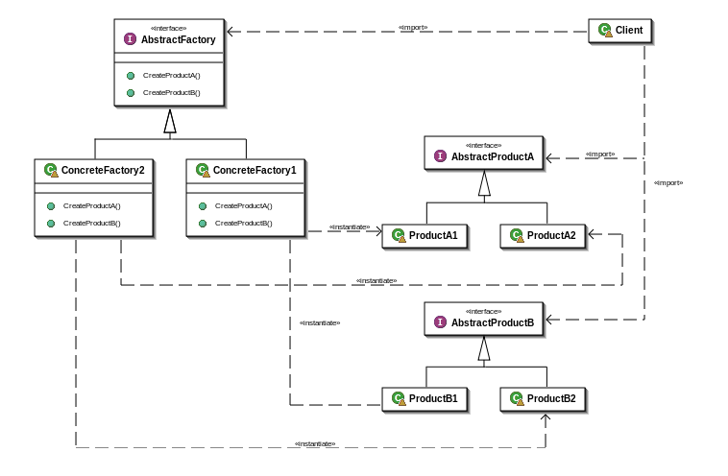
Abstract Factory Pattern
Notes:
产品族概念 （Windows/Unix）

Slide 7
Singleton Pattern
Lazy initialization
Synchronize
Enum

Slide 8
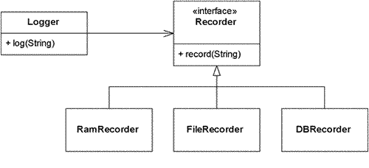
Strategy Pattern
Notes:
HttpTransportAdapter
InitiateRaptorCommand
RaptorCommandFactory
ReportServiceImpl

Slide 9
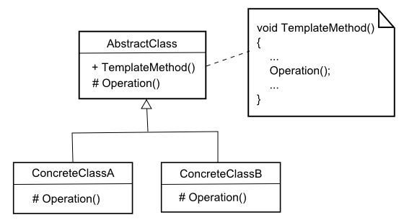
Template Pattern
Notes:
AbstractValidator
区别：整体部分 / 独立

Slide 10
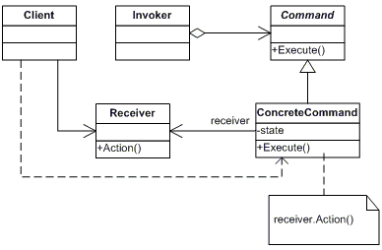
Command Pattern
Notes:
策略模式对付的问题域通常是一个，就是说，多个策略只是处理同一个问题，而命令模式对付的是多个问题域，就是很多不同的命令来做不同的事情。
RaptorServerCommand.java
HttpTransportAdapter.java

Slide 11
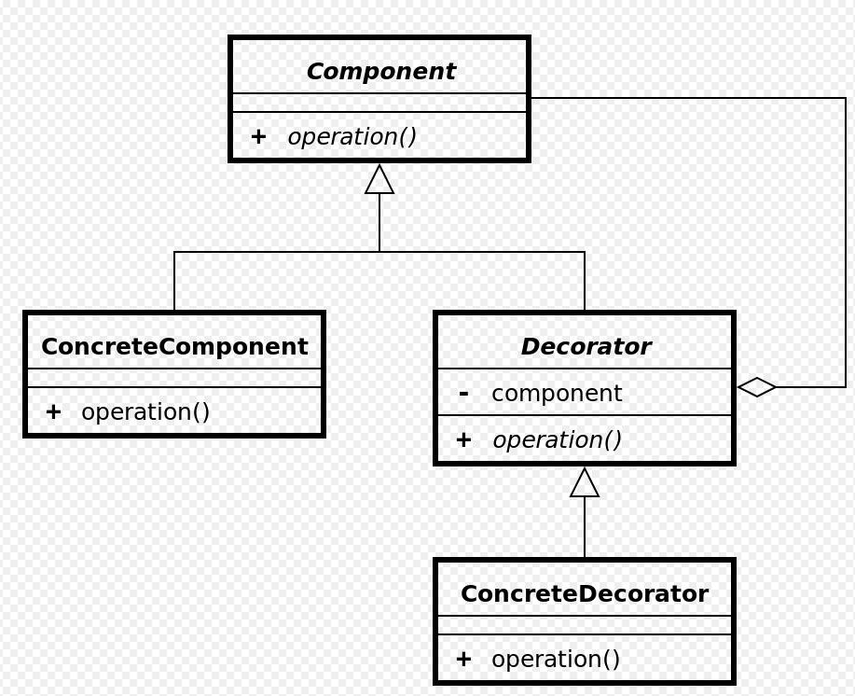
Decorator Pattern

Slide 12
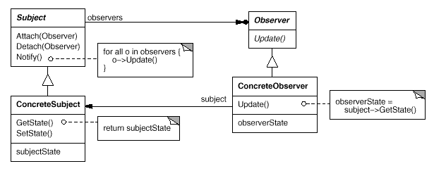
Observer Pattern

Slide 13
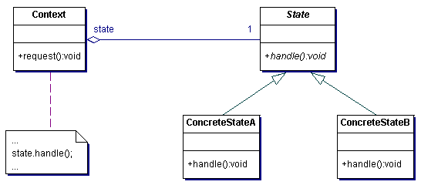
State Pattern

Slide 14
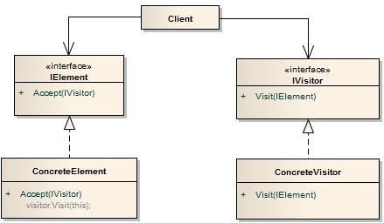
Visitor Pattern

Slide 15
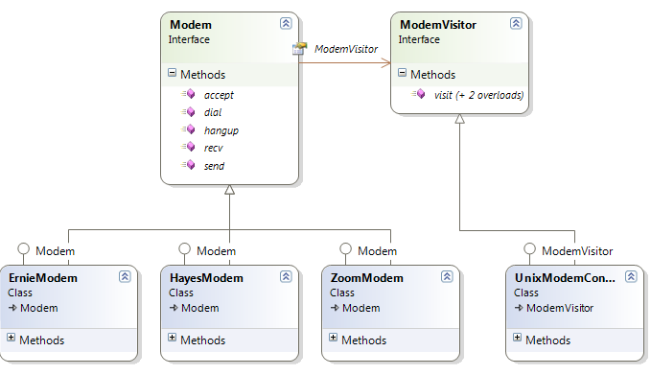
Function Matrix

Slide 16
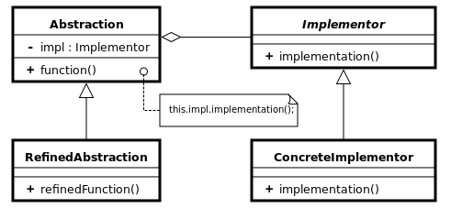
Bridge Pattern

Slide 17
Adapter Pattern
Façade Pattern
Notes:
封装变化

Slide 18
Factory Pattern
Singleton Pattern
Strategy Pattern
Template Pattern
Command Pattern
Decorator Pattern
Observer Pattern
State Pattern
Adapter Pattern
Façade Pattern
Visitor Pattern
Bridge Pattern
Proxy Pattern
Builder Pattern
Null Object Pattern
Composite Pattern
Iterator Pattern
Notes:
Builder: UploadReportCommand.java

Slide 19

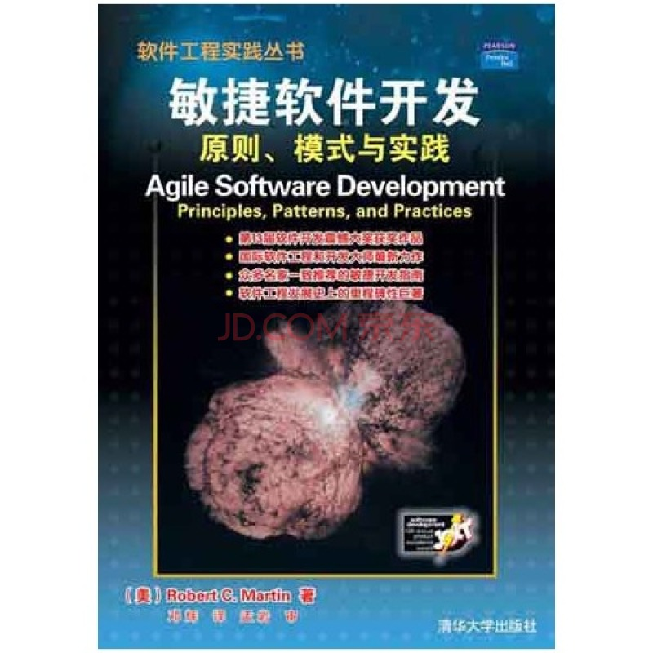
Reference

Slide 20
Thank you!

